Slide 1
CS5551 Advanced Software Engineering Tutorial 1 August 25, 2016
UMKC

Slide 2
Topics to cover
Git
ZenHub
Visio

Slide 3
Git Basic Tasks
1. Create Git remote repository using Git account
2. Clone Git repository to your local
3. Use Git to add file into local
4. Modify files and use Git to commit change
5. Use Git to push the commit to remote
6. Use Git to pull (sync) content with remote

Slide 4
Git Project Management Tasks
1. Use Git to branch a project
2. Use Git to check different branches
3. Use Git to merge different versions

Slide 5
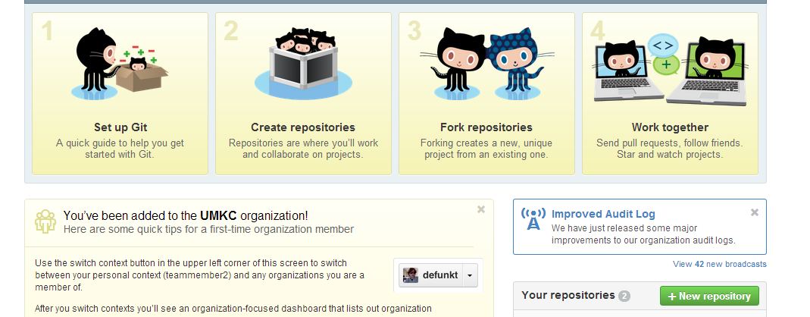
Git 1. Create Repository

Slide 6

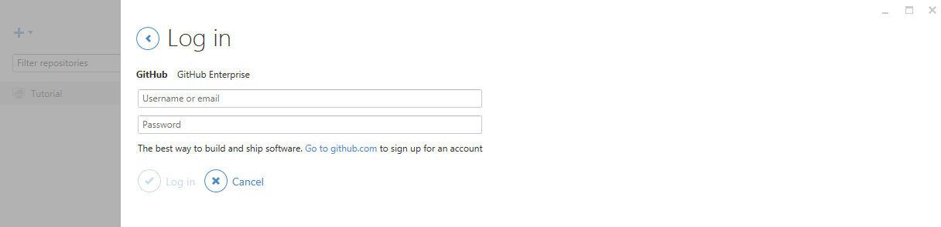
Git
For Windows user, please open GitHub desktop by double clicking icon
login to your GitHub desktop with your GitHub account (It is very important to login before you do the rest of steps. Because after you login, you secure connection has been made)

Slide 7

Git
Then open Git Shell by clicking icon

Slide 8
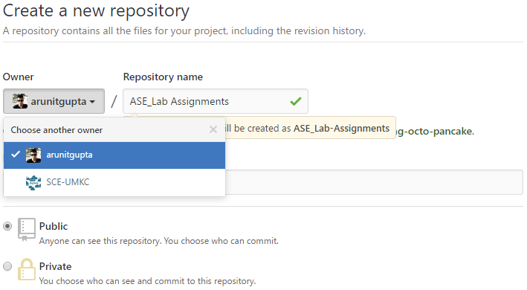
Git 1. Create Repository
We will add each group to our created organization “SCE-UMKC”.
Create your project under Owner SCE-UMKC, give a project name. That is the repository
If you are not the member of SCE-UMKC yet, you can just create a repository under your username

Slide 9
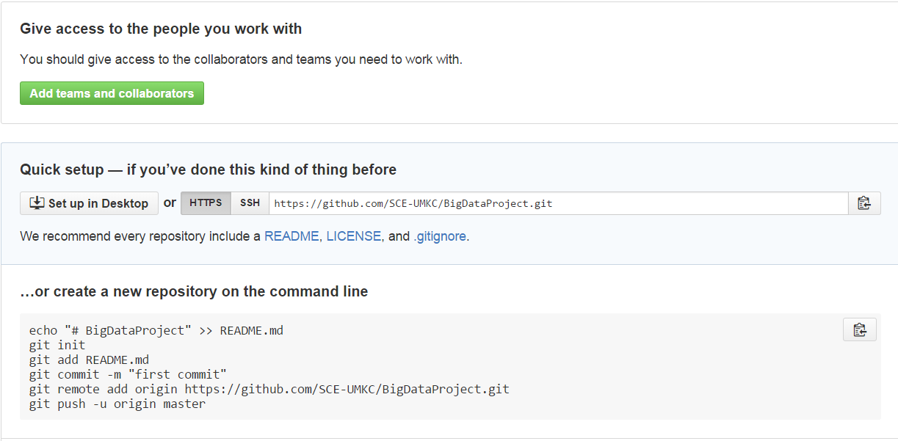
Git 2. Clone repository to your local
git clone https://github.com/xxxxxxx.git

Slide 10
Git
After clone, you will find a folder has the same name as repository
Use the following command to go inside the folder
cd <folder_name> (e.g., cd BigDataProject)

Slide 11
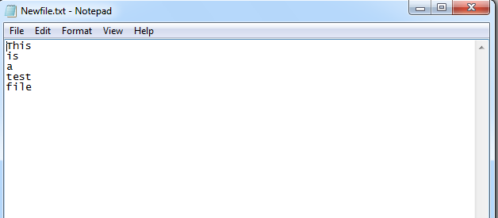
Git 3. Add file to local repository
In the local repository folder, we can add a new file
If you are a Linux or a Mac user
vi Newfile.txt
If you are a Windows user
echo This is a test file > Newfile.txt
If you add a file from local
git add Newfile.txt

Slide 12
Git 4. Commit this change
git commit –m ‘Someone committed on Sometime’
After commit, you can check git status to see if work directory clean
git status

Slide 13
Git 5. Push the change to remote
For Windows user, we first test if we are able to connect to GitHub
ssh -T git@github.com
https://help.github.com/articles/generating-ssh-keys

Slide 14
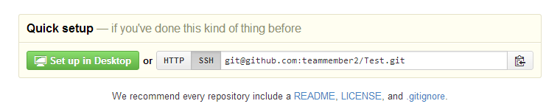
Git 5. Push the change to remote
Setup remote connection by SSH git address git remote set-url origin git@gxxxxxx.git

Slide 15
Git 5. Push the change to remote
Now you can push all to GitHub
git push --all

Slide 16
Git 6. Sync local with remote
If something change in remote, for sync purpose, you can type
git pull

Slide 17
For now, Windows users have done all basic steps.
But for Linux and Mac users, there are some more steps

Slide 18
Git 5. Push the change to remote (Non-Windows User)
For Linux or Mac user, we have more work to do before pushing change to remote
We have to setup SSH
Here are several steps

Slide 19
Git 5. Push the change to remote (Non-Windows User)
Generate a SSH key with your github email address
ssh-keygen -t rsa –C ‘your_email@example.com‘
It will ask you the file name to save this key and passphrase. Give the key name and make passphrase as empty.
For example, we give key name as id_rsa, key pair would be:
id_rsa and id_rsa.pub

Slide 20
Git 5. Push the change to remote (Non-Windows User)
(2) Add your new private key to the ssh-agent
ssh-agent -s
eval $(ssh-agent)
ssh-add Your_Key_Name

Slide 21
Git 5. Push the change to remote (Non-Windows User)
(3) Copy public key to your github account
vi Your_Key_Name.pub
Copy the content of this file

Slide 22
Git 5. Push the change to remote (Non-Windows User)
(4) Copy key to your GitHub account
In the user bar in the top-right corner of any page, click setting button
Click SSH Keys in the left sidebar.
Click Add SSH key.
In the Title field, add a descriptive label for key
Paste your key into the "Key" field.
Click Add key.

Slide 23
Git 5. Push the change to remote (Non-Windows User)
(5) SSH to github for testing ssh -T git@github.com

Slide 24
Git 5. Push the change to remote (Non-Windows User)
(6) Switching remote URLs from HTTPs to SSH git remote set-url origin git@gxxxxxx.git

Slide 25
Git 5. Push the change to remote (Non-Windows User)
(7) Now you can push
git push --all

Slide 26
Git 6. Sync local with remote (Non-Windows User)
If something change in remote, for sync purpose, you can type
git pull

Slide 27
Git Project Management 1. Branch
A and B work on the same project
A wants to develop on feature A
B wants to develop on feature B
They work in parallel
BranchA and BranchB

Slide 28
Git Project Management 1. Branch
Create a branch
git branch branchA
Delete a branch
git branch –d branchA
Force delete a branch
git branch –D branchA
Rename the current branch
git branch –m branchA

Slide 29
Git Project Management 2. Checkout
A and B has to checkout their own branch to work on
git checkout branchA
git checkout branchB

Slide 30
Git Project Management 3. Merge
User A works on featureA, after finish, user A commit it with the message ‘finish featureA’
git commit –m ‘finish featureA’
User B works on featureB, after finish, user B commit it with the message ‘finish featureB’
git commit –m ‘finish featureB’
User C works on main features on master branch, user C commit it with the message ‘finish main features’
git commit –m ‘finish main features’

Slide 31
Git Project Management 3. Merge
In master, we can merge all features and delete branchA and branchB
git checkout master
git merge branchA
git merge branchB
git branch –d branchA
git branch –d branchB

Slide 32
Git Project Management 3. Merge
At last, master push all change to remote repository
git push --all

Slide 33

ZenHub for GitHub project management
ZenHub is a GitHub plugin for agile project management
It needs either Chrome or Firefox as the browser.
Go to https://www.zenhub.io/
Click “Add ZenHub to GitHub”, it will install a plugin on your browser
Click plugin icon
It will ask you to login to GitHub (You have to create your GitHub account before)
After login, you have to grant the permission for ZenHub to access your GitHub project
Done

Slide 34
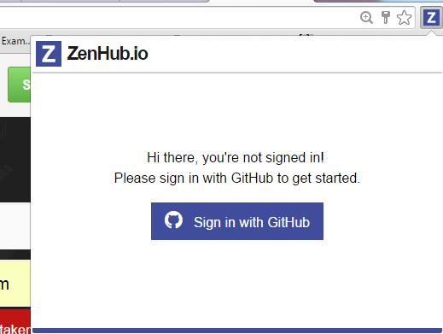

Slide 35
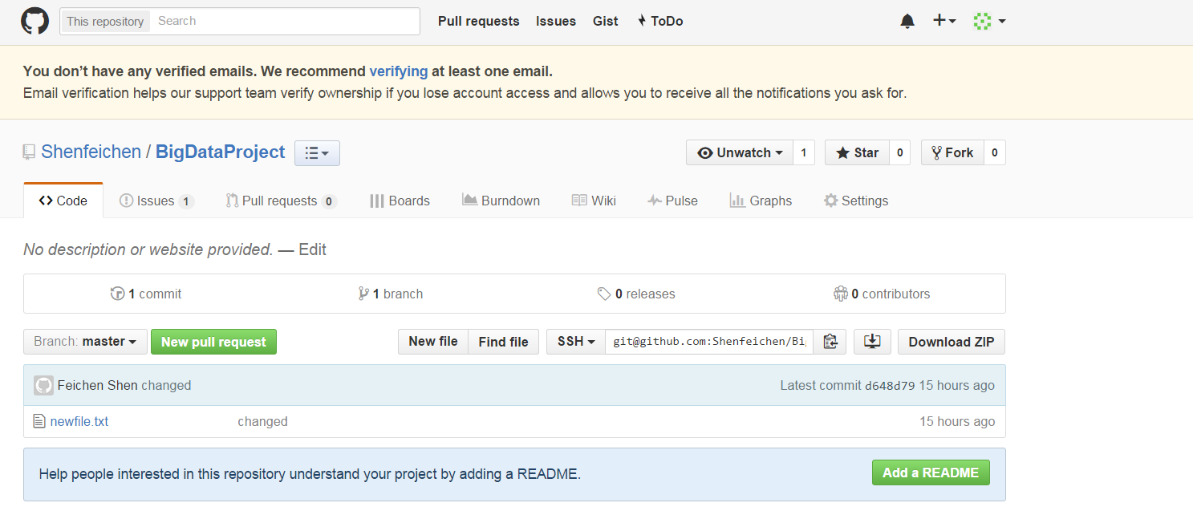
ZenHub
Click issues, we can add issues
Click Boards, we can drag and drop stories to different completion status
Click burndown, we can add milestone and assign different stories to milestone and then generate burndown chart

Slide 36
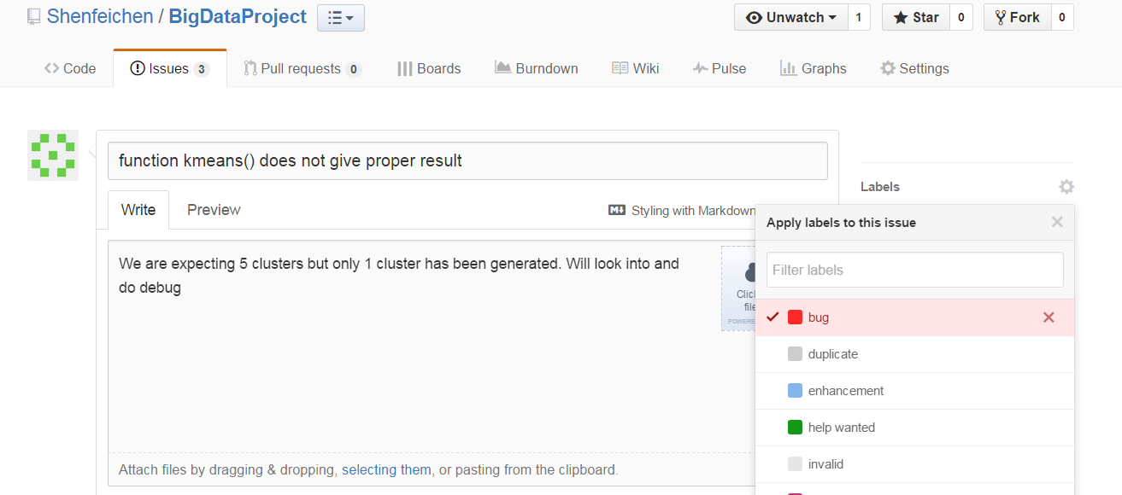
Add Issues
Click issues
Click New issues

Slide 37
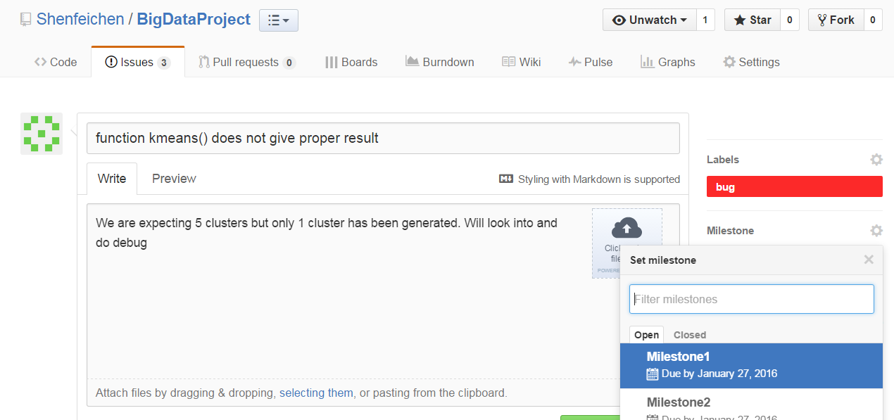
Add Issues

Slide 38
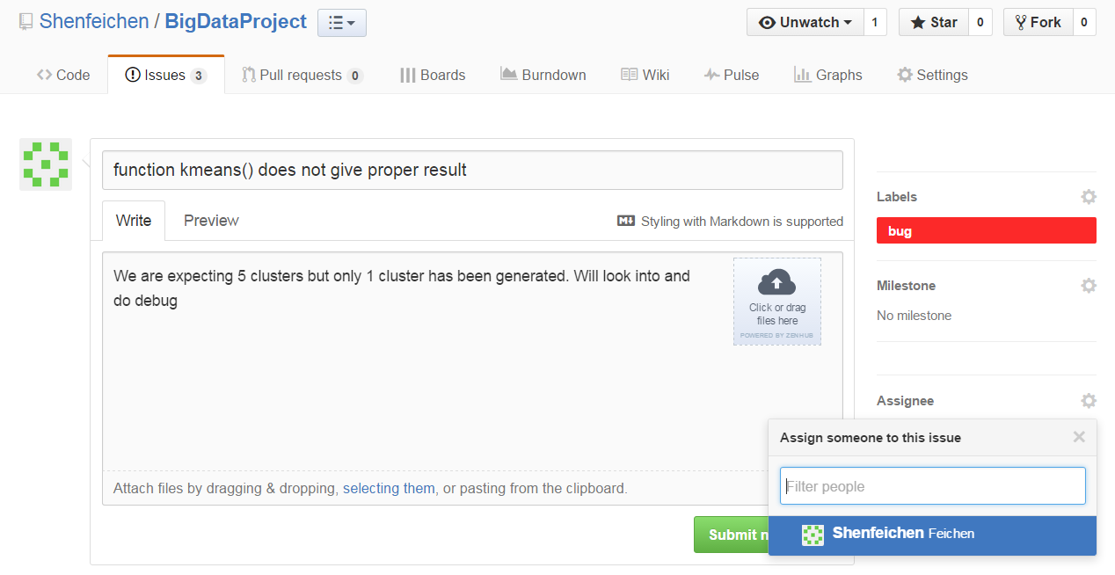
Add Issues

Slide 39
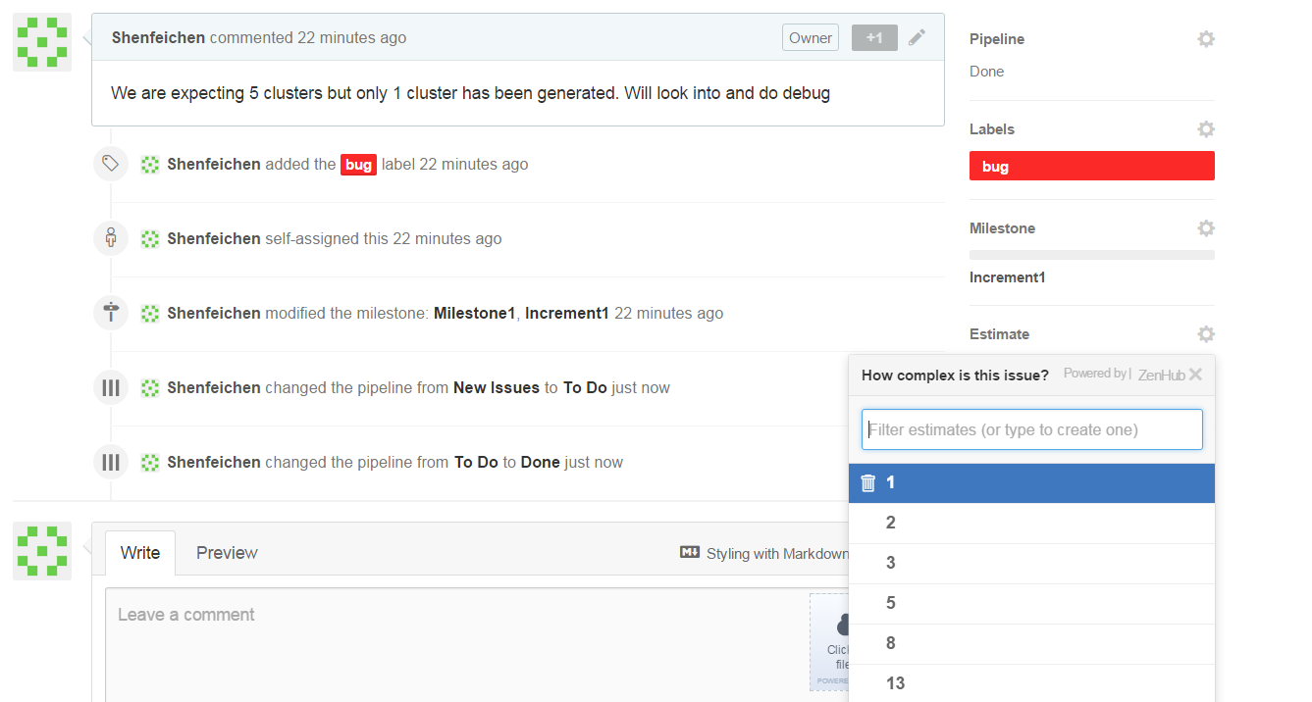
Add Issues
Story point is a arbitrary measure used by Scrum teams. This is used to measure the effort required to implement a story.

Slide 40
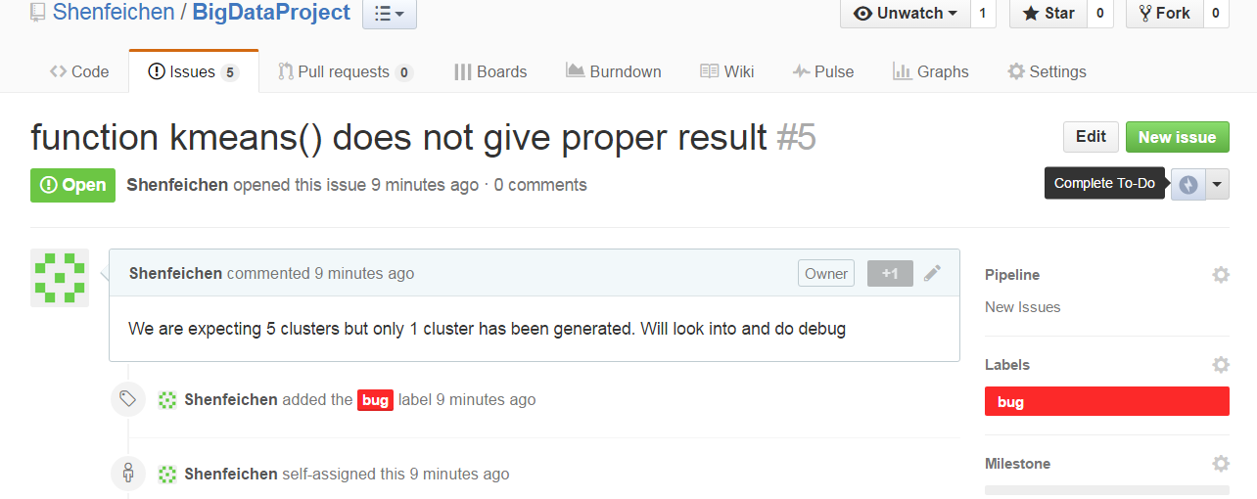
Add Issues

Slide 41
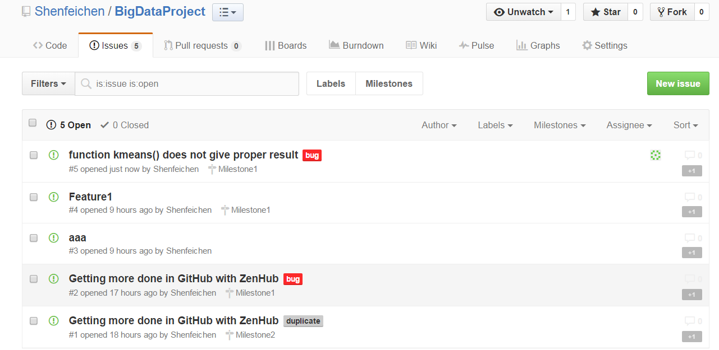
Add Issues

Slide 42
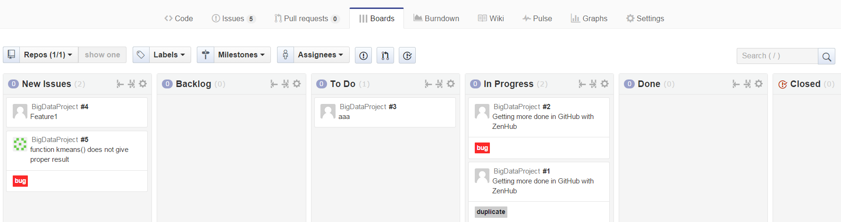
Board

Slide 43
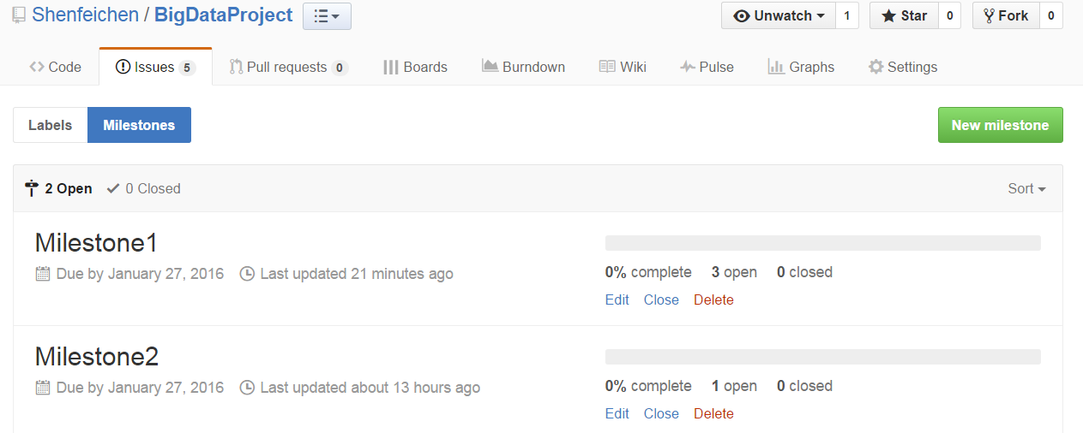
Add Milestones
Issues → Milestones → New Milestones
You can create Milestones

Slide 44
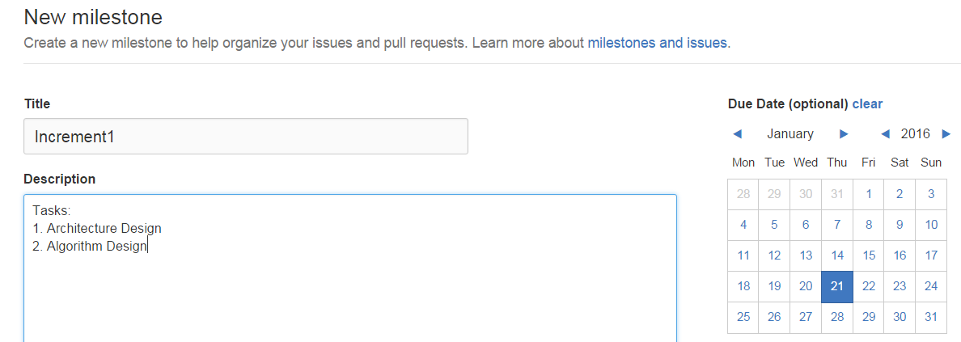
Add Milestones

Slide 45
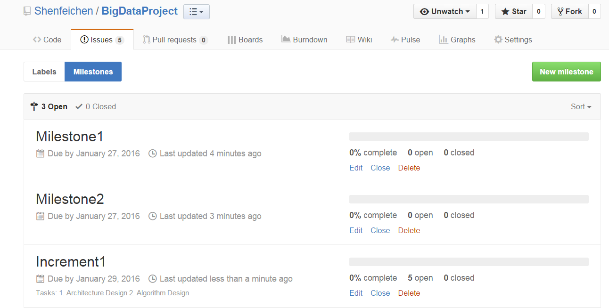

Slide 46
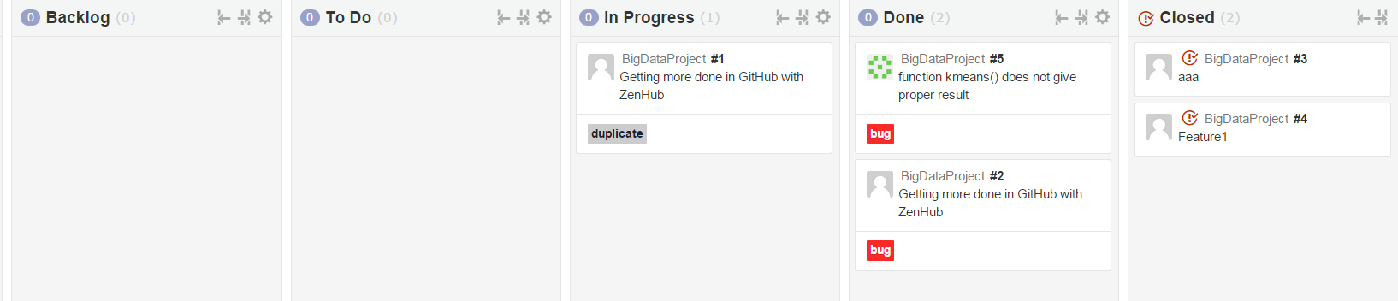
Add Milestones
Increment1 has 5 issues
I drag two of them to “Closed” status

Slide 47
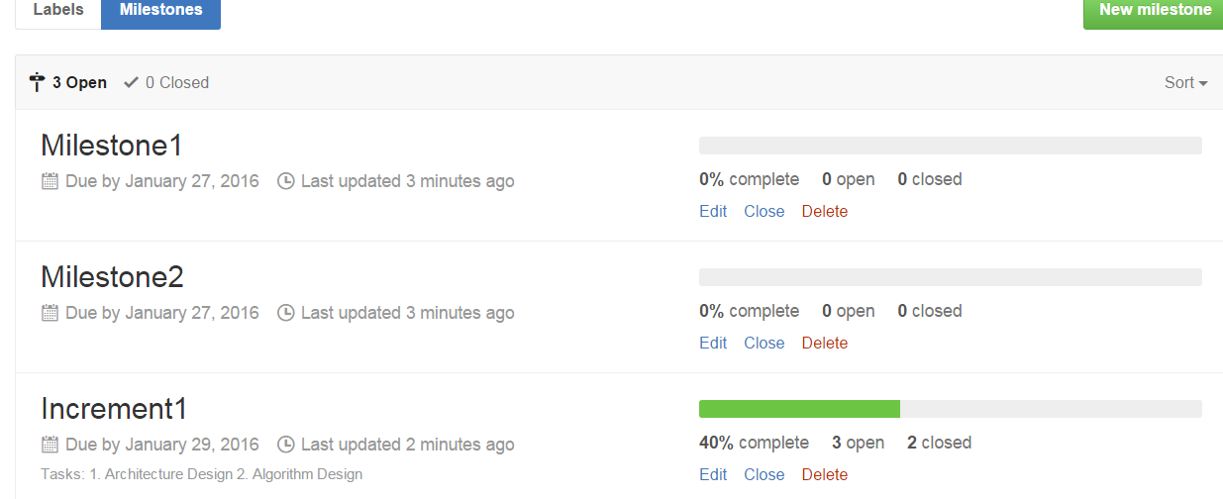
Add Milestones
Then the complete of Milestones will also change

Slide 48
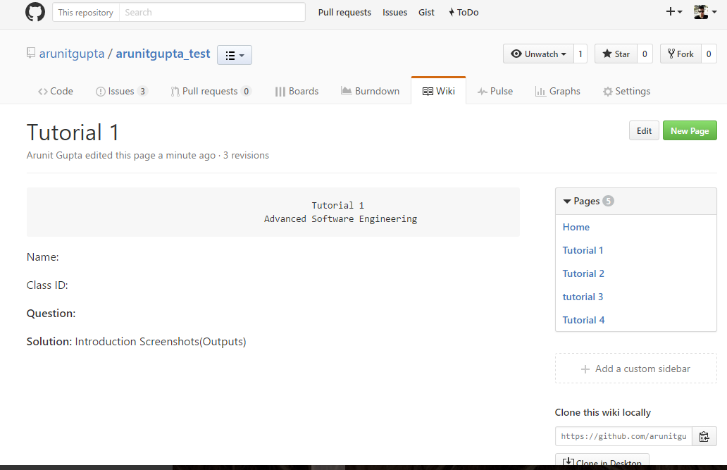
Wiki
Every GitHub repository comes equipped with a section for hosting documentation, called a wiki.

Slide 49
Build Burndown Chart
A burn down chart is a graphical representation of work left to do versus time.

Slide 50
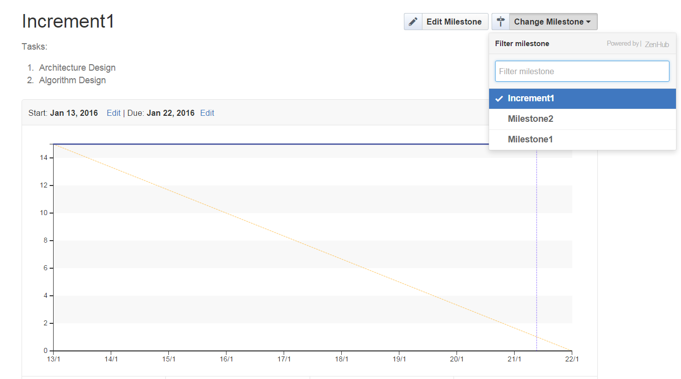
Build Burndown Chart
Go to burndown option, select a specific milestone, to see the burndown chart

Slide 51
Visio
A application used to design:
Basic Flowchart
UML Model Diagram
Database Model Diagram
Cross-Functional Flowchart
……

Slide 52
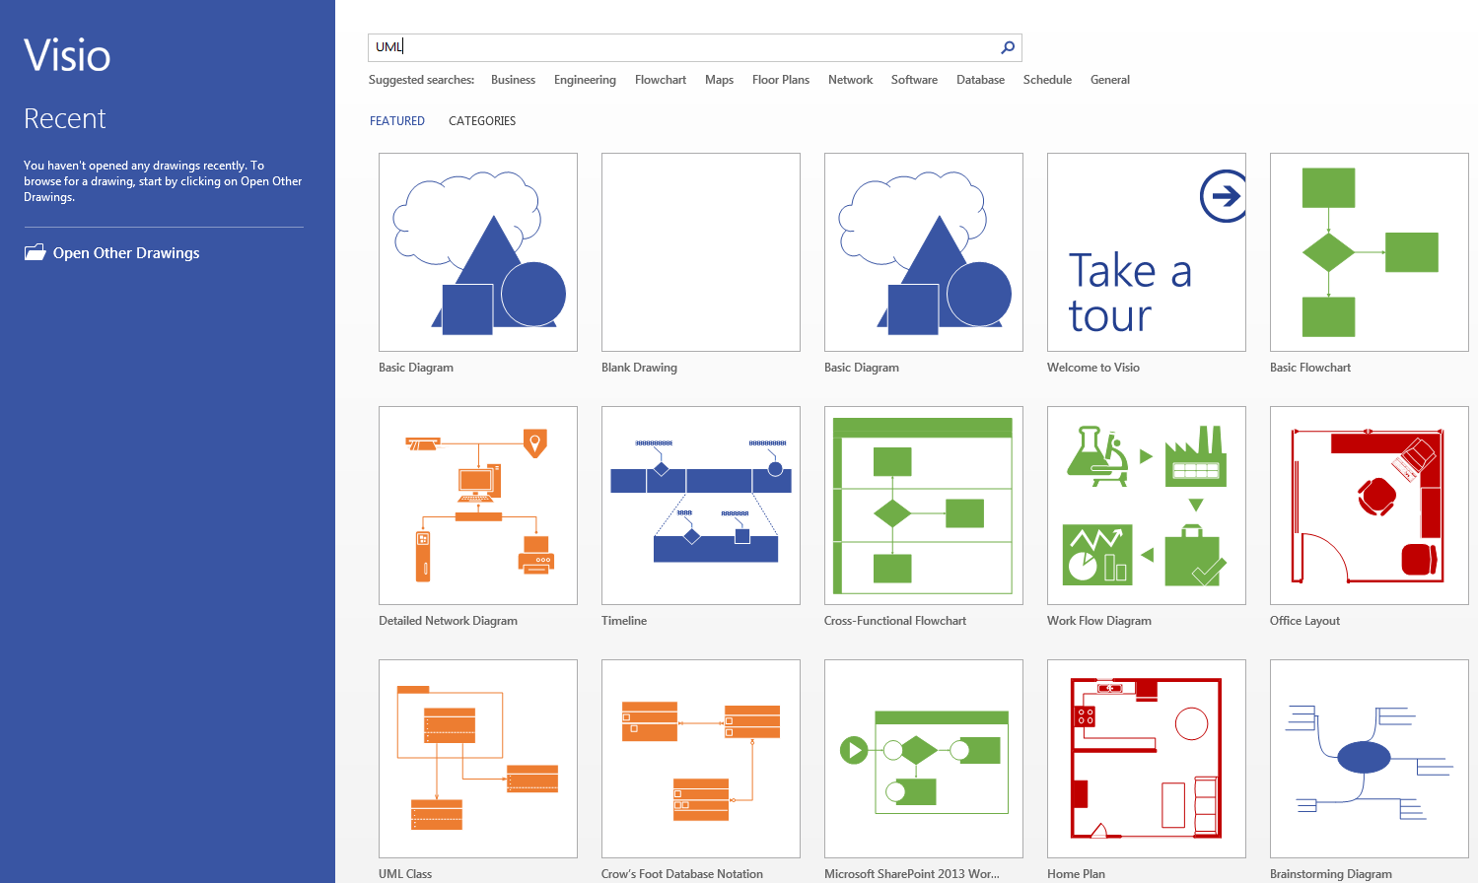
Visio : Start Page
This is the start page for visio 2013

Slide 53
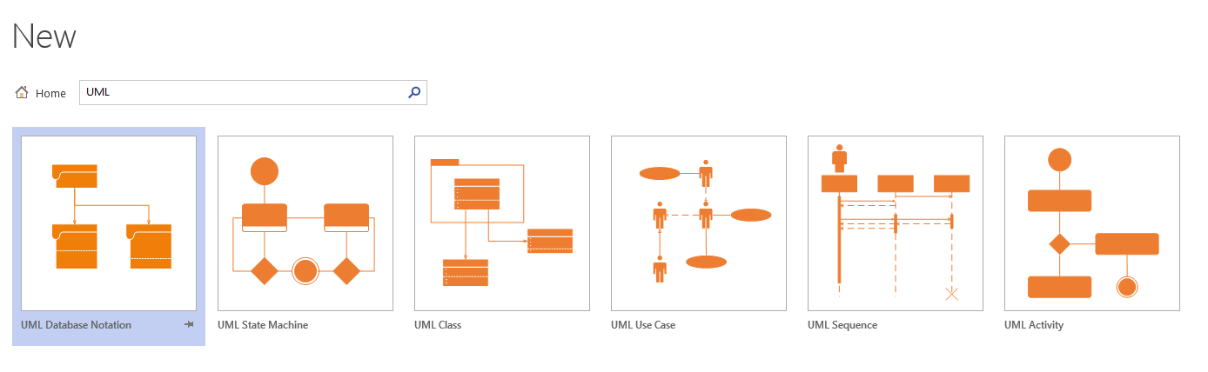
Visio : UML Diagrams
Type “UML” in search box to get all UML related diagram, we will focus on Use case Diagram, Class Diagram, Sequence Diagram and State Diagram

Slide 54
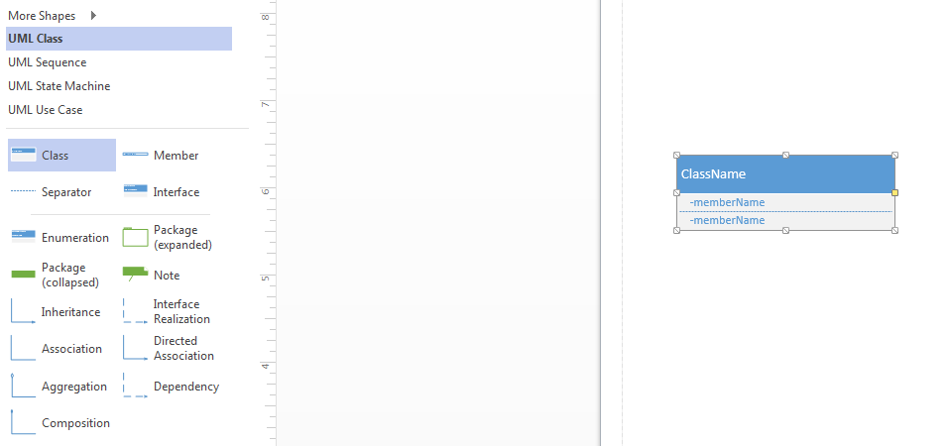
Class Diagram
Drag and drop the items from list to canvas

Slide 55

Class Diagram
Double click to change class Name, attribute Name and method Name
Class Name
Attribute
Method

Slide 56
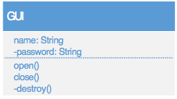
Class Diagram
Public Variable: Can be accessed from outside the class, use “+” or nothing to describe it.
Private Variable: Can only be accessed from inside the same class, use “-” to indicate it.
Attribute Format: (-/+/) AttributeName: DataType
Method Format: (-/+/) MethodName ()

Slide 57
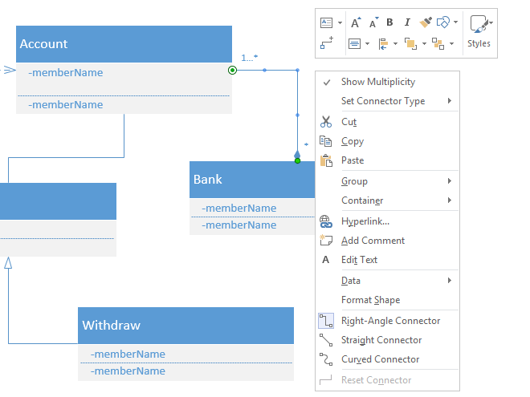
Class Diagram
Add a association between two classes
Right click and click Show Multiplicity to display multiplicity between two classes
Multiplicity could be 1…*, 0…* or *, 1, 0…1

Slide 58
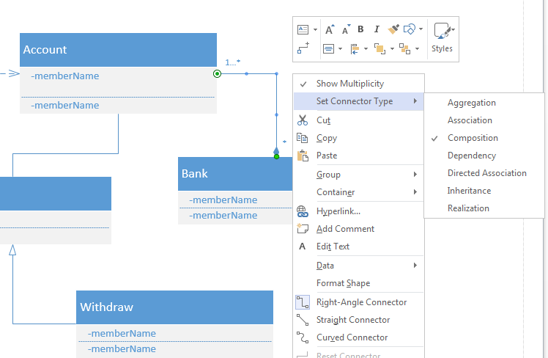
Class Diagram
Choose Set Connector Type
We can select association to be Aggregation, Composition, Dependency…

Slide 59
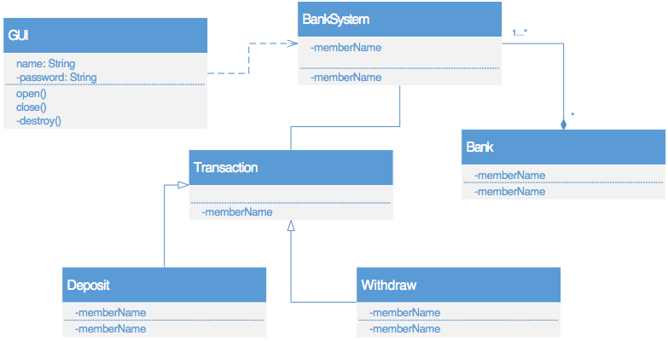
Class Diagram
GUI is depended on Bank System
Many Bank Systems composite the whole bank
Bank System associates with Transaction
Deposit and Withdraw are two basic sub transaction that generalized from transaction

Slide 60
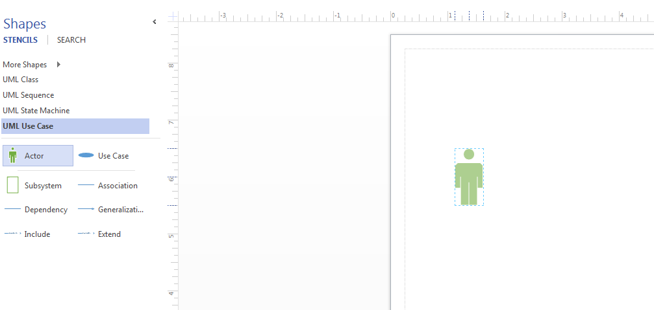
Use Case Diagram
Drag and drop the items from list to canvas
Double click items to change name

Slide 61
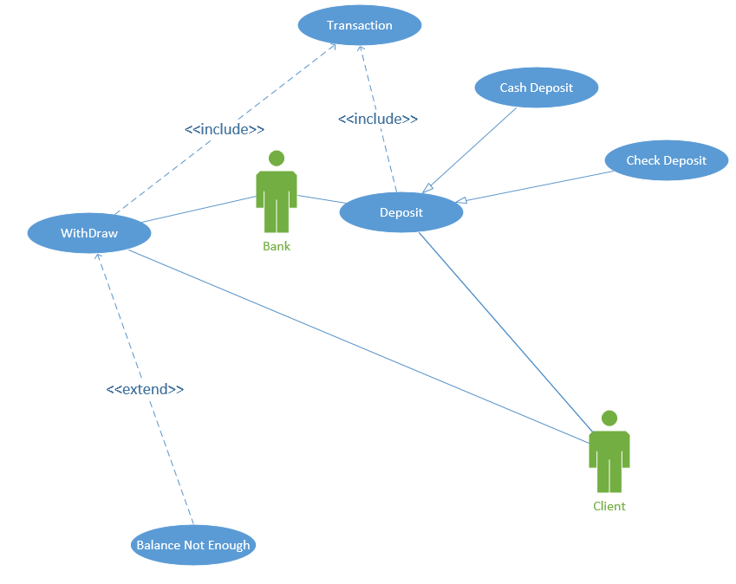
Use Case Diagram
Inclusion: For the purpose of eliminate repetition of reusing use case. One use case is a sub step of another one
Generalization: Like inheritance
Extension: The use case which contains exceptions for another one

Slide 62
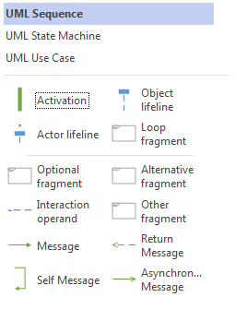
Sequence Diagram
Drag any item from sequence diagram list and drop to the canvas
Double click to change the name

Slide 63
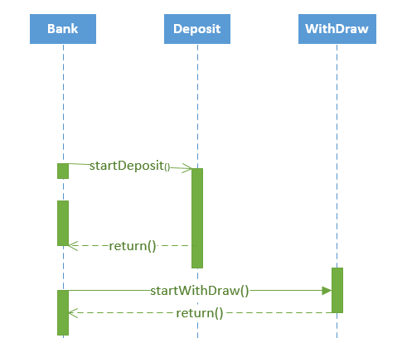
Sequence Diagram
Add activation to object lifeline when corresponding class is doing its work
Double click to change the name
Draw message, Asynchronous message, return message properly
Asynchronous message
Return
message

Slide 64
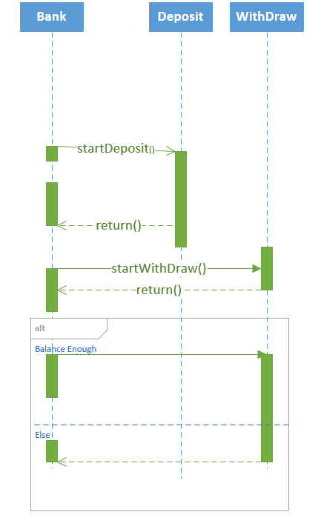
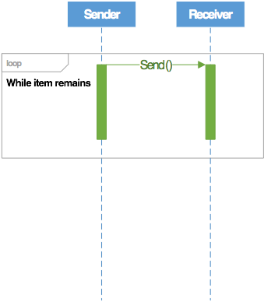
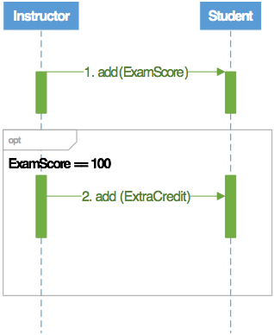
Sequence Diagram
Alternative Fragment: Similar like if condition in programming. Go either way based on the condition. Mutual exclusion
Loop Fragment: Always loop when fulfills condition
Optional Fragment: Execute fragment when condition is true

Slide 65
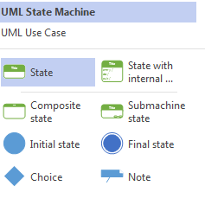
State Diagram
Drag items in state machine list and drop on canvas

Slide 66
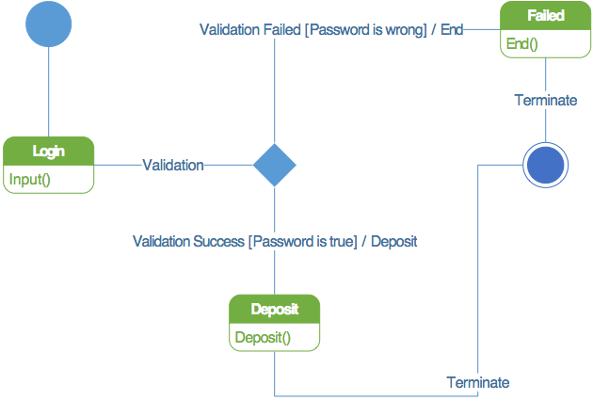
State Diagram
Lines between different state is transition
Format of transition can be Event or Event [Guard] / Action
Event triggers transition; Guard must be true; Action invokes method
Initial State
State
Action
Guard
End State

Slide 67
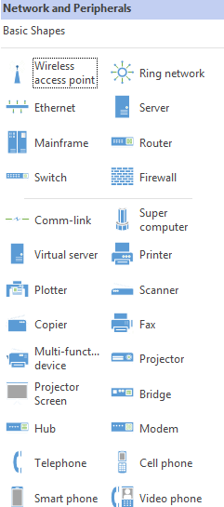
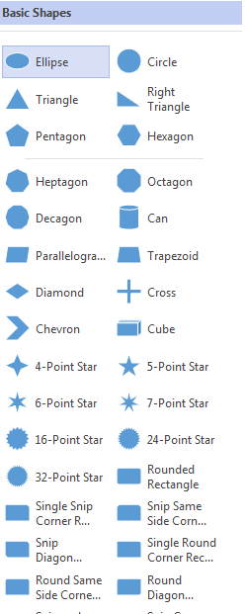
System Architecture

Slide 68
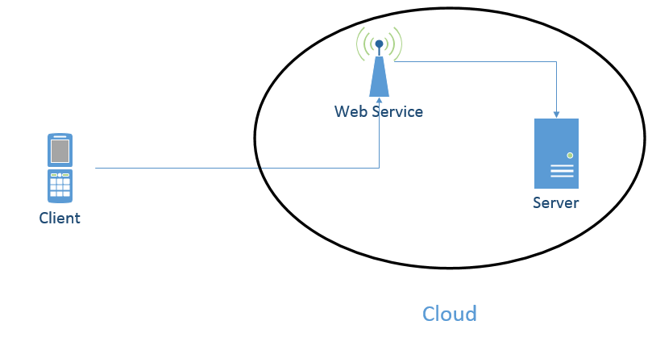
System Architecture

Slide 69
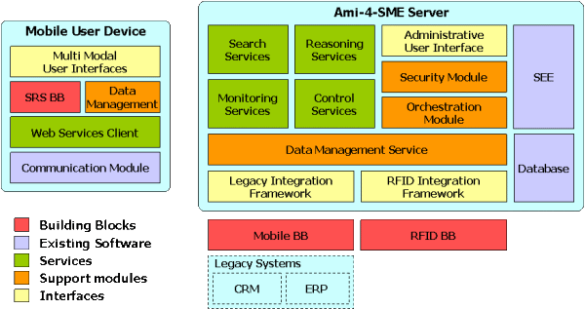
Software Architecture
Ami-4-SME platform http://ami4sme.org/results/platform.php

Slide 70
Lab Submission
Create a repository for all Lab assignment submissions
Create a folder for each lab assignment and place all code inside source code folder
Use Github wiki pages to submit reports for each lab
Include all wiki links in README.md file

Slide 71
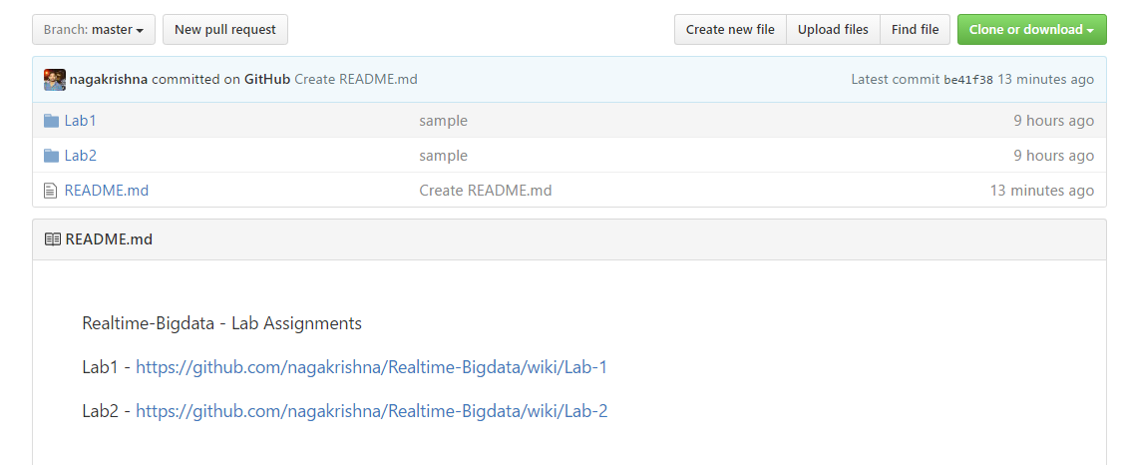
Wiki: Lab Submission

Slide 72
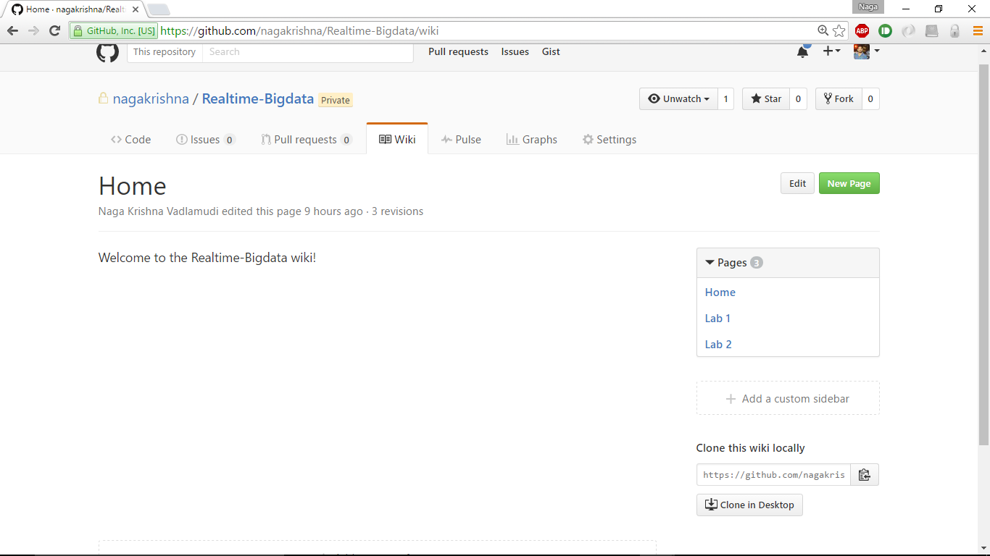
Wiki: Lab Submission

Slide 73
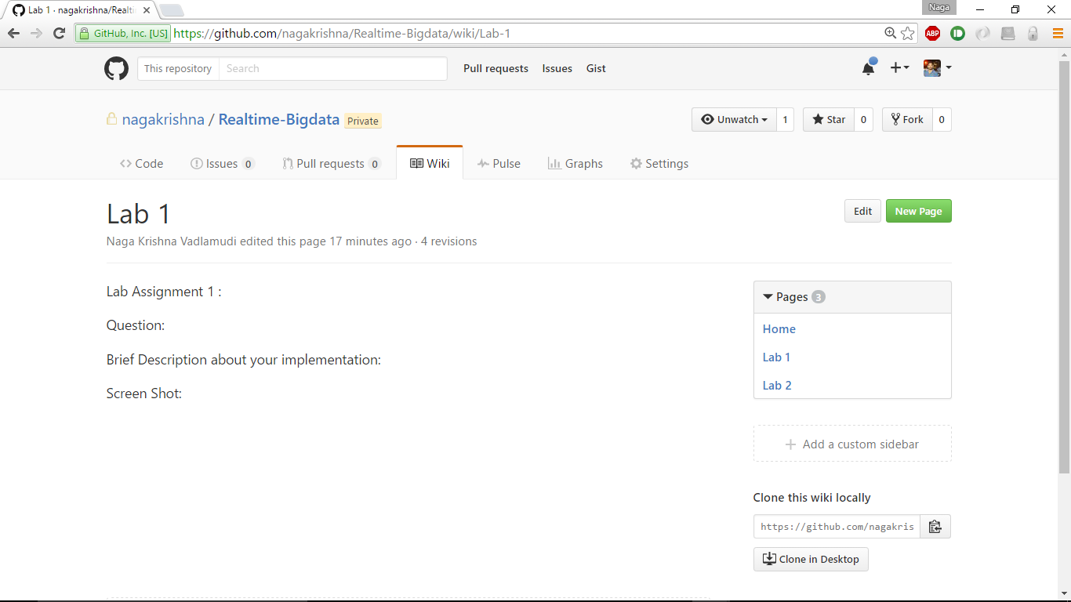
Wiki: Lab Submission

Slide 74
END

